Slide 1

Rifat Hossain
EDGE ID: 06

Slide 2
Organizational Balance Sheet & Income Statement
Walton Hi-Tech Industries PLC.
Absorption Costing Income Statement
For the Year Ended 30 June, 2023
Particulars | Amount
Revenue Cost of Goods sold (21731 *1,957,529) Gross margin Administrative Expenses (942,954,464+430,656,380) Selling & Distribution Expenses (1,288,395,254+5,120,895,864) Net operating Income | 66,374,271,405 (42,540,311,284)
 | 23,835,208,706
 | (1,373,610,844) (6,409,291,118)
 | 16,053,555,329

Slide 3
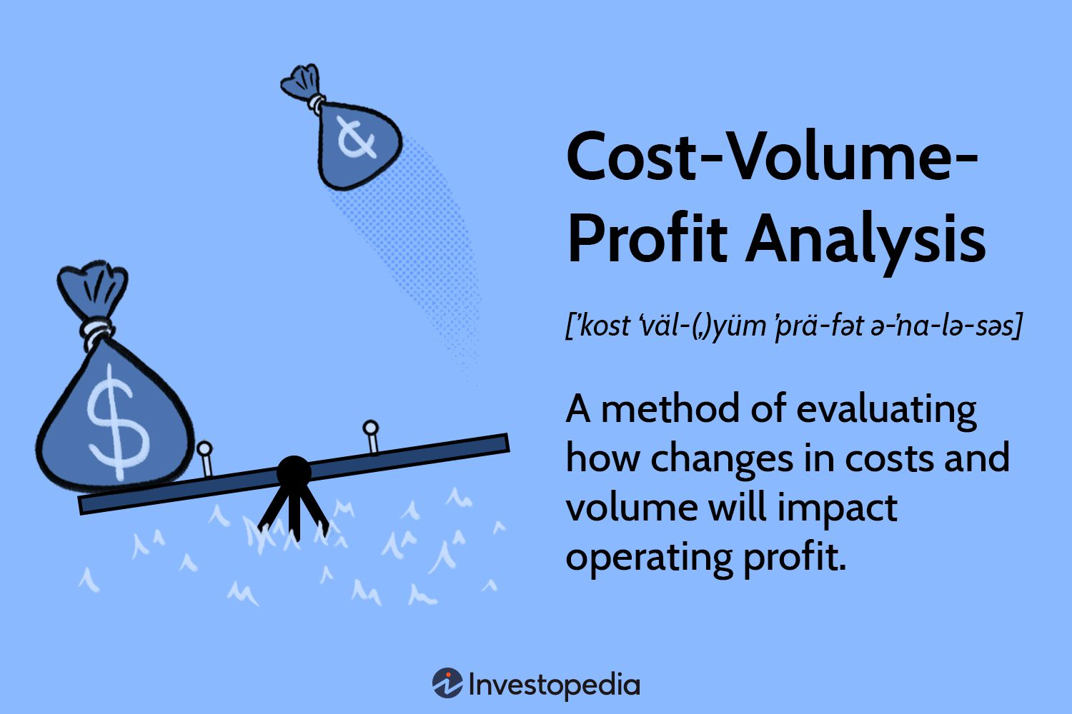
Cost-Volume-Profit (CVP) Analysis

Slide 5
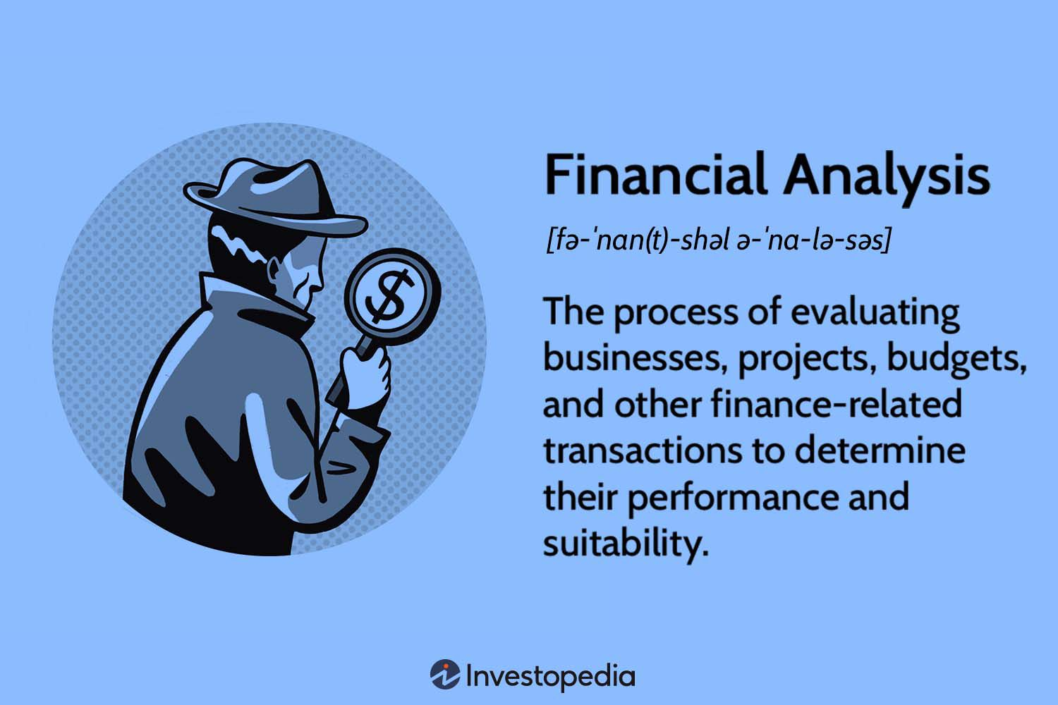
FINANCIAL ANALYSIS

Slide 6
Current Ratio or Working Capital Ratio Current ratio is a relationship of current assets to current liabilities Current assets means the assets that are either in the form of cash or cash equivalents or can be converted into cash or cash equivalents in short time (say within a year) like cash, bank balances, marketable securities, sundry debtors, stocks, bills receivables, prepaid expenses.

Slide 7
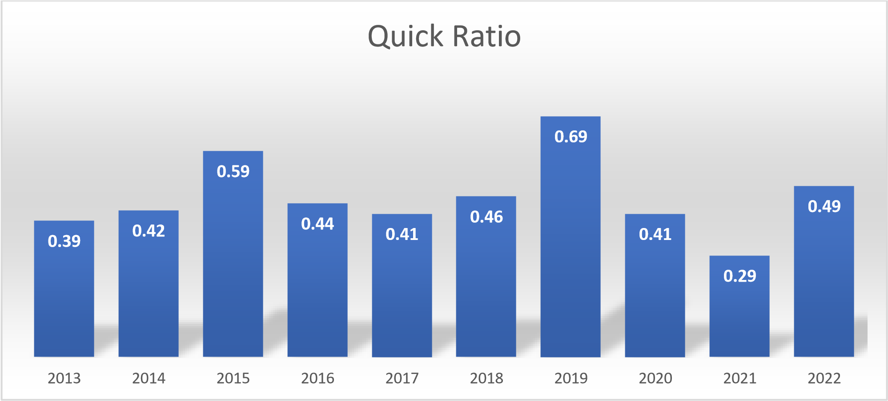
Liquid Ratio or Quick Ratio or Acid Test Ratio Liquid ratio is a relationship of liquid assets with current liabilities. It is fairly stringent measure of liquidity. Liquid assets are those which are either in the form of cash or cash equivalents or can be converted into cash within a very short period. Liquid assets are computed by deducting stock and prepaid expenses from the current assts

Slide 8
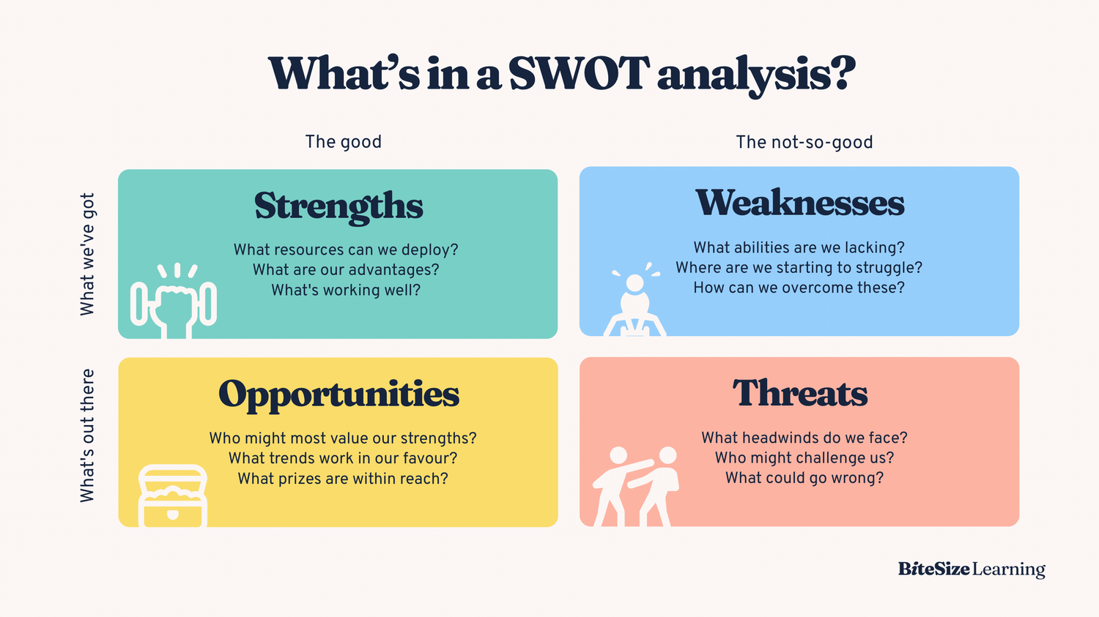

Slide 9


